Slide 1
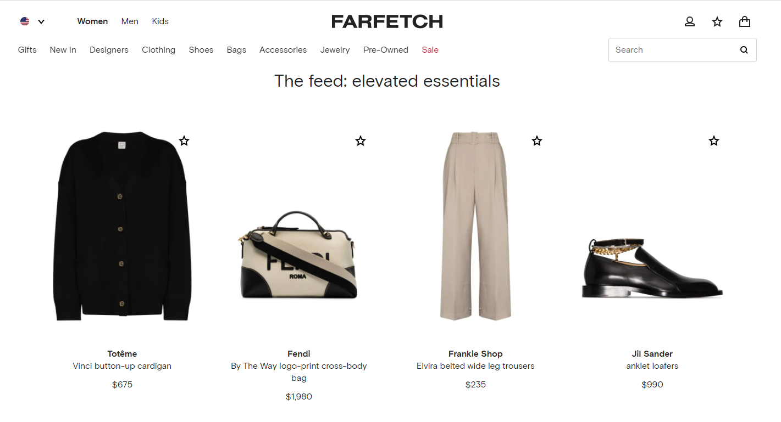
FARFETCH
PRODUCT INSIGHTS
LUXURY RETAIL
E-COMMERCE

Slide 2

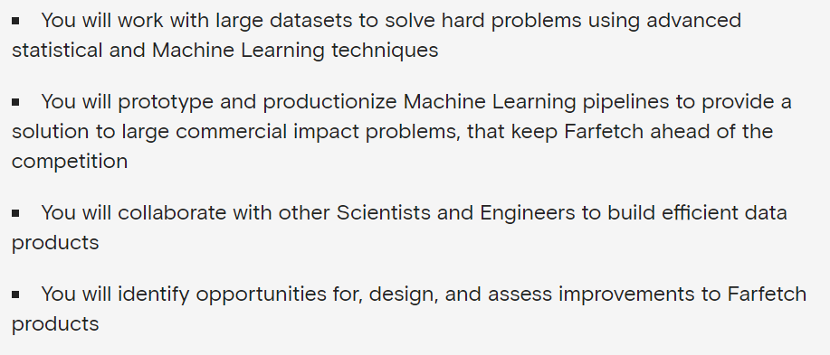
PRODUCT INSIGHTS Q#1: WHAT ARE THE TOP CLOTHING PRODUCT CATEGORIES? Q#2: IS FARFETCH SELLING INTO THE FALL 2020 TRENDS?

Slide 3
FARFETCH: THE COMPANY
FARFETCH =
MARKETPLACE FOR INDEPENDENT RETAILERS
POSTS SELECTIONS ON ITS MARKETPLACE
RETAILERS HANDLE FULFILLMENT
FARFETCH GETS COMMISSION
GLOBAL LUXURY ECOMMERCE CHANNEL
FOUNDED IN 2007
2019 REVENUE $1BILLION
+335,000 SKUS
CUSTOMERS IN 190 COUNTRIES

Slide 4
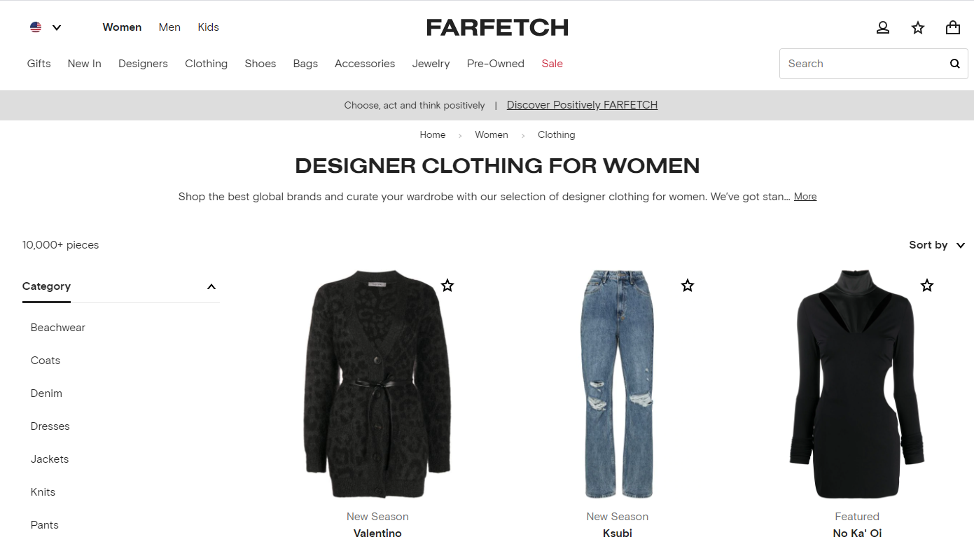

Slide 5
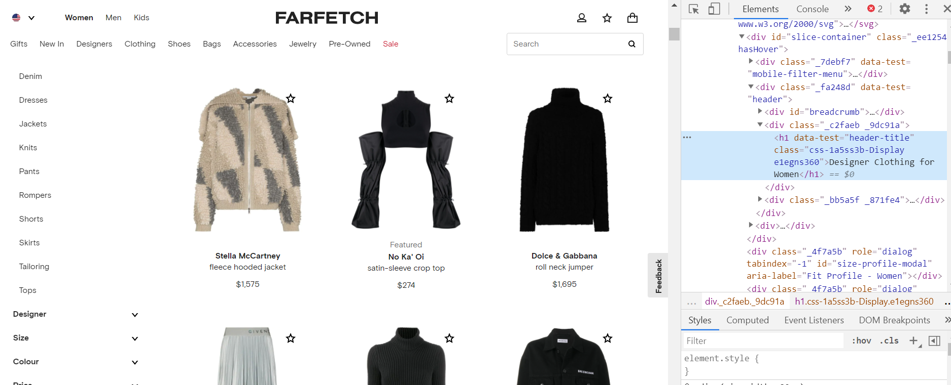
1. THE SCRAPE
“ALL CLOTHING”
451 PAGES (180 SKUS / PAGE)
81,180 SKUS PULLED
SELENIUM (ASPX)
AUTO REFRESH ISSUES
3 ATTEMPTS
5 HOURS FINAL DATA PULL
40 SEC PER PAGE TO SCRAPE

Slide 6
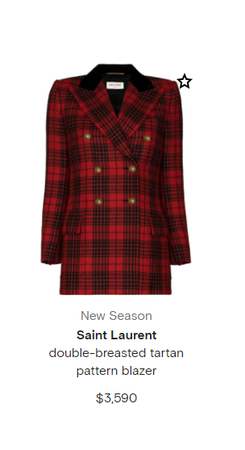
2. DATA CLEANING
PRE-PROCESSING TO DO:
FILLED IN BLANK CELLS
CONVERTED PRICES TO INTEGERS
DESCRIPTION TO LOWER CASE
CREATED NEW ATTRIBUTES FROM DESCRIPTION (PRODUCT CATEGORIES)
ATTRIBUTES SCRAPED:
DESIGNER
DESCRIPTION
PRICE
SEASON

Slide 7
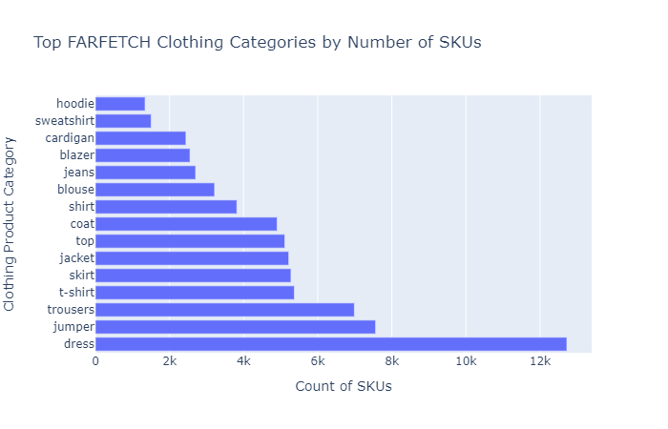
Q#1: WHAT WOMEN’S CLOTHING CATEGORY HAS THE MOST SKU LISTINGS?
NUMBER OF SKUS INDICATE THE POPULARITY OF THE PRODUCT TYPE
TOP 15 CATEGORIES REPRESENT 88% OF TOTAL SKUS
#1 DRESSES: 15%
#2 JUMPER: 9%

Slide 8
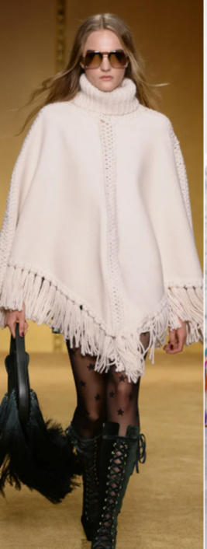
Q#2: OF THE TOP 10 FALL 2020 FASHION TRENDS* FOR WOMEN’S APPAREL, IS FARFETCH SELLING CURRENT TRENDS?
PONCHO/CAPE
CARDIGAN
FRINGE
CHECKS/PATCHWORK/TARTAN
BUBBLE/BALLOON
LEATHER
ARGLYE
VEST
SKIRT SUIT
METALLIC
*BRITISH VOGUE

Slide 9
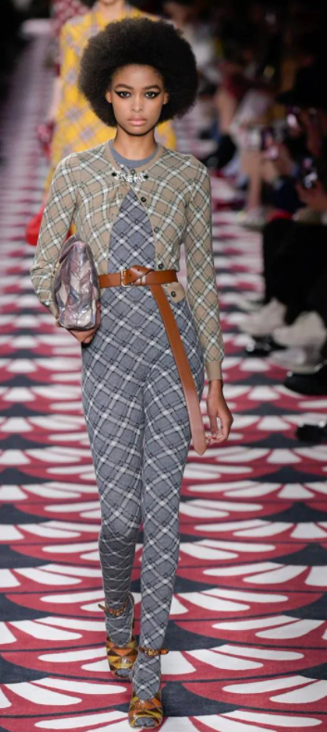
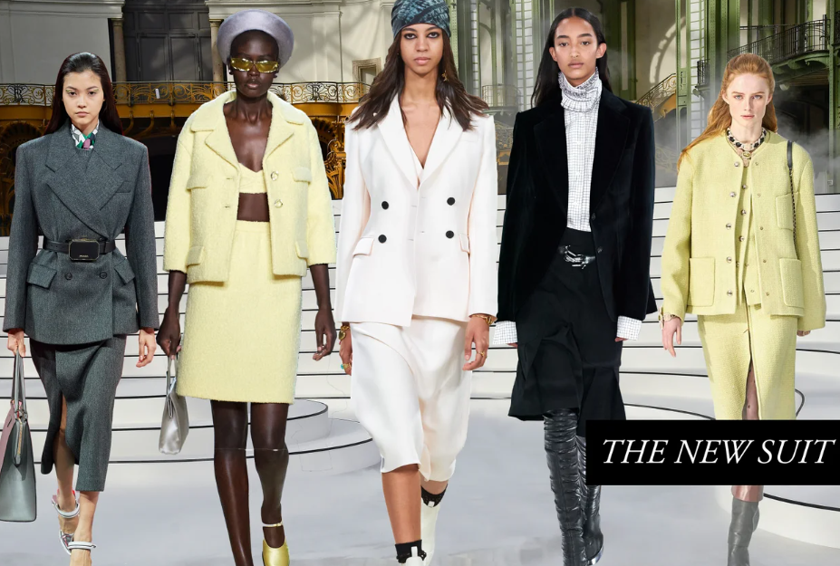

Slide 10
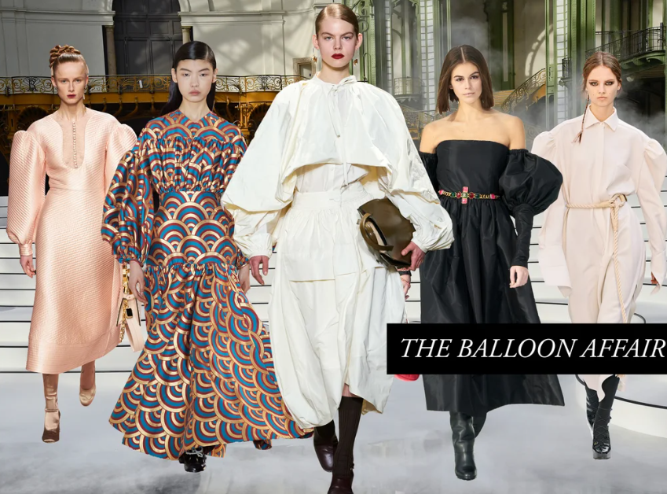
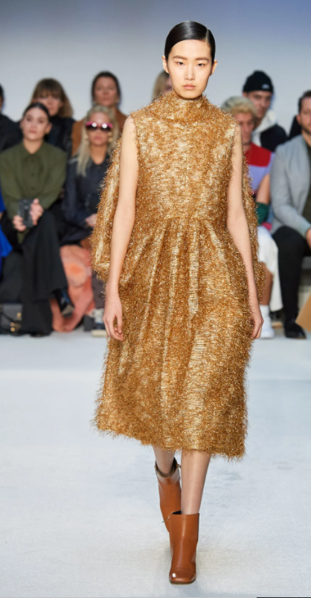

Slide 11
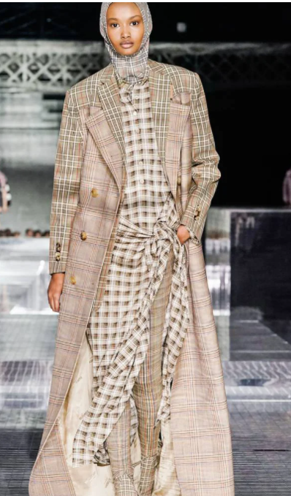
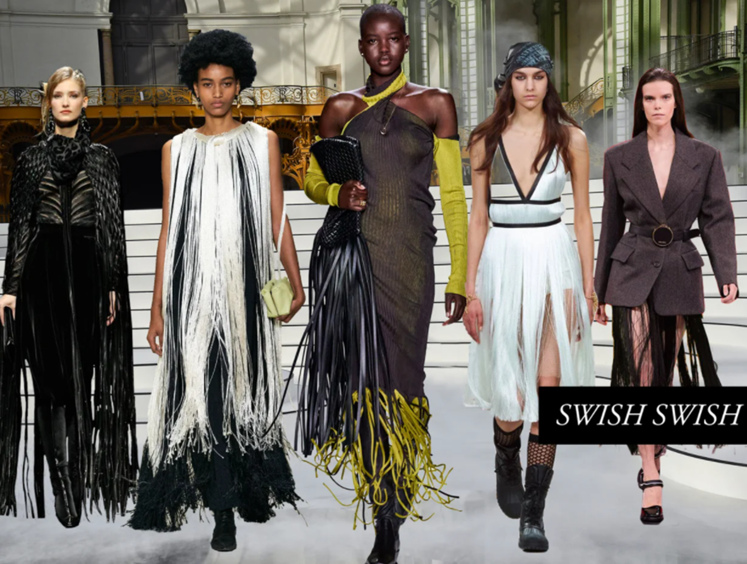

Slide 12
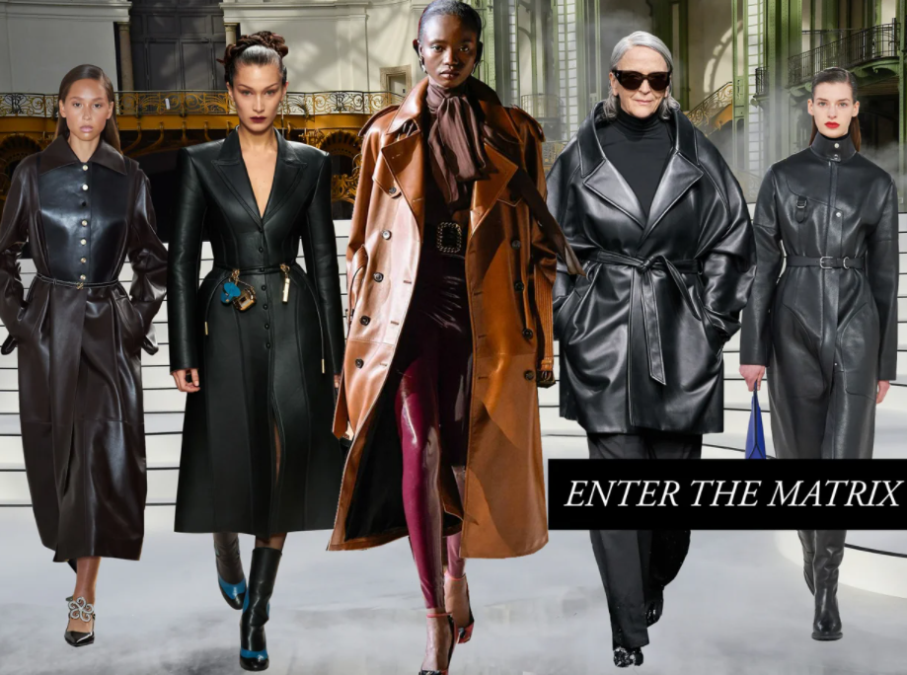
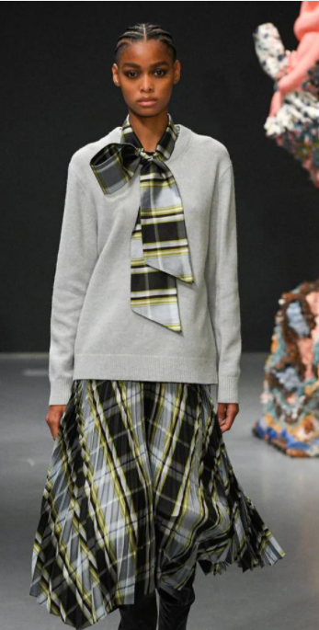

Slide 13
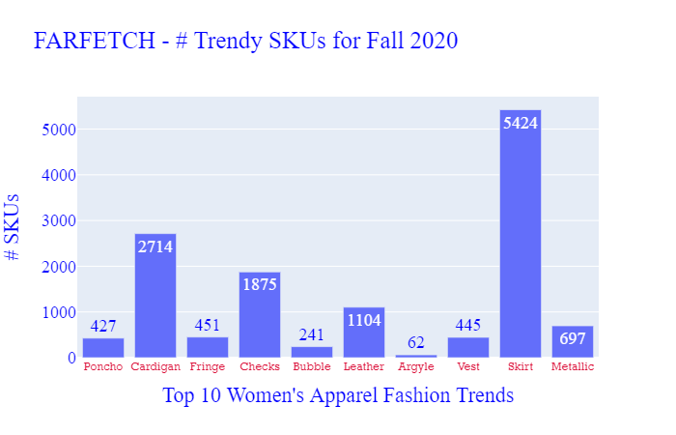
QUESTION#2: IS FARFETCH SELLING INTO THE FALL 2020 TRENDS?
15% OF ALL SKUS ARE A FALL 2020 TREND
TARGET SHOULD BE 20% NOVELTY, 80% BASICS

Slide 14

KEY TAKEAWAYS
WITHIN WOMEN’S CLOTHING, DRESSES & JUMPERS HAVE THE MOST SKU REPRESENTATION
THE FARFETCH WOMAN IS VERY FEMININE & SPECIAL OCCASION ORIENTED
FALL 2020 TRENDS REPRESENT 15% OF SKUS, UNDER THE 20% TARGET BUT NOT BAD CONSIDERING IT’S A CAUTIOUS YEAR

